Slide 1
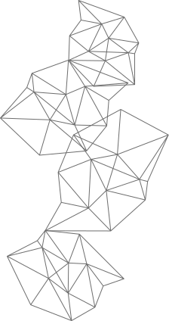
CROWDFUNDING IN EDUCATION
USING BLOCKCHAIN
Presented By:
Ayushi Maske (15)
Anish Desai (46)
Priyush Khobragade (52)
Sagar Thakur (71)
Guide:
Prof. Asra Sadaf Mam

Slide 2
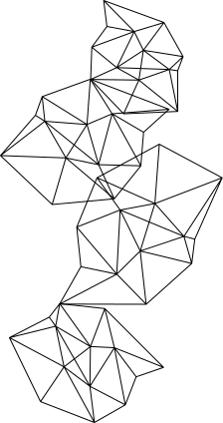
INDEX
2
1
What is Crowdfunding
Introdution
4
3
Benefits of crowdfunding
Why This Project
5
6
Challenge
Literature Survey
8
Case Studies in Educational Crowdfunding
7
Proposed System
9
10
Future Trends and Collaborative Models
Result

Slide 3
INTRODUCTION:
•A crowdfunding platform that leverages blockchain technology for a more secure and transparent fundraising process.
•Blockchain eliminates the need for intermediaries, allowing direct peer-to-peer transactions between project creators and backers.
•Enhanced security through cryptographic techniques, making it difficult for fraudulent activities to occur.
•All transactions and project updates are recorded on a public ledger, providing complete transparency to all participants.
•Tokenized assets can be traded on secondary markets, providing liquidity to backers.

Slide 4
WHAT IS CROWDFUNDING?
Crowdfunding is a method of raising capital or funding for a project, venture, or cause by collecting small contributions from a large number of individuals, typically via the internet or social media platforms.
It enables entrepreneurs, artists, non-profit organizations, and others to access funds without relying on traditional sources such as banks or venture capitalists.
Instead of seeking large sums of money from a single source, such as a bank or venture capitalist, crowdfunding involves reaching out to a broad audience of potential backers or supporters who each contribute a relatively small amount of money.

Slide 5

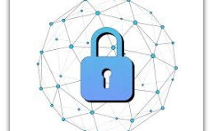
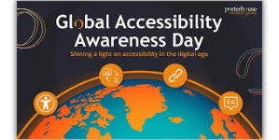
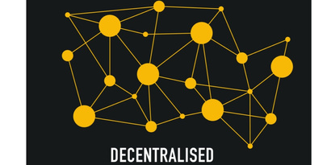
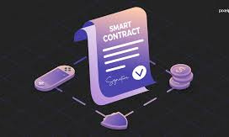
Why This Project:
Transparency
This transparency builds trust among donors, as they can verify how their funds are being used and track the progress of funded projects in real-time.
Security
The cryptographic principles underlying blockchain technology ensure the security and integrity of transactions, reducing the risk of fraud, data manipulation, or misappropriation of funds in educational crowdfunding initiatives.
Global Accessibility
This global accessibility expands the reach of educational crowdfunding campaigns, increasing the likelihood of reaching funding goals and achieving project objectives.
Decentralization
Blockchain-based crowdfunding platforms operate on decentralized networks, allowing educational projects to raise funds directly from a global pool of contributors without the need for intermediaries such as banks or financial institutions.
Smart Contracts
Smart contracts, which are self-executing contracts with predefined rules and conditions encoded on the blockchain, can automate and enforce the terms of educational crowdfunding campaigns.

Slide 6
BENEFITS OF CROWDFUNDING:
Access to Capital: Crowdfunding provides project creators with access to capital without the need for traditional funding sources such as banks or venture capitalists. This enables entrepreneurs, artists, non-profit organizations, and others to pursue their projects or ventures without the barriers often associated with traditional financing.
Market Validation: Crowdfunding serves as a form of market validation, allowing project creators to gauge interest in their ideas or products before bringing them to market. By presenting their projects to a wider audience and receiving feedback from backers, creators can assess demand and refine their offerings accordingly.
Community Engagement: Crowdfunding fosters community engagement and collaboration by connecting creators with passionate supporters who share their interests or values. Backers become advocates for the project, spreading the word and generating buzz through social media, word-of-mouth, and other channels.
Marketing and Exposure: Crowdfunding campaigns serve as marketing platforms, raising awareness and generating publicity for projects or ventures. The public nature of crowdfunding platforms attracts media attention and can help project creators attract additional supporters, customers, or partners beyond the crowdfunding campaign itself.
Feedback and Iteration: Crowdfunding provides creators with valuable feedback from backers, enabling them to iterate and improve their projects based on user input. This iterative process helps creators refine their ideas, address potential issues, and deliver a better final product or outcome.

Slide 7
Challenge
Regulatory Compliance: One of the significant challenges of implementing crowdfunding in education using blockchain is navigating the complex regulatory landscape. Educational institutions and crowdfunding platforms must comply with existing financial regulations, securities laws, and data protection regulations, which may vary by jurisdiction.
Security and Privacy Concerns: Blockchain technology offers inherent security features such as cryptographic encryption and decentralization. However, ensuring the security and privacy of sensitive educational data, financial transactions, and personal information stored on the blockchain remains a challenge.
Adoption and User Education: Educating stakeholders, including educational institutions, donors, and beneficiaries, about the benefits and potential risks of crowdfunding in education using blockchain is essential for widespread adoption. Many stakeholders may have limited knowledge or understanding of blockchain technology and its applications in crowdfunding.
Technical Complexity: Implementing blockchain-based crowdfunding platforms requires technical expertise in blockchain development, smart contract programming, and decentralized application (DApp) development. Educational institutions may face challenges in acquiring the necessary technical skills and resources to design, develop, and maintain blockchain-based crowdfunding solutions.
Scalability and Performance: Scalability and performance limitations of blockchain networks, such as throughput, latency, and transaction processing speed, pose challenges for large-scale crowdfunding campaigns in education. As the number of contributors and transactions increases, blockchain networks may experience congestion and delays, impacting user experience and efficiency.
Trust and Credibility: Building trust and credibility among stakeholders, including donors, educational institutions, and beneficiaries, is critical for the success of crowdfunding initiatives in education using blockchain. Establishing transparency, accountability, and integrity in fundraising activities, as well as demonstrating the impact and outcomes of funded project

Slide 8
Literature Survey
In paper contributes to the emerging literature on financial technology by presenting the case of crowdfunding in financial inclusion. The rationale behind this inquiry is to demonstrate the relevance of crowdfunding to financial inclusion, and how might blockchain technology fuel the development of crowdfunding. This paper also constitutes one of the first attempts to analyse crowdfunding in. Thus, we believed that this result could apply in periodontology dentistry field in the near future.
When we did research this In paper work aims at creating an economical, multimodal, personal oral crowdfunding A decentralized application (DApp) to help new developer in industry or new start upto overcome their problem of funds. Our purpose is to make digital world more advance for every single person using Blockchain technology. Due to our DApp new start up or new project will join, from that our community get bigger and bigger, and we can help each other.
Crowdfunding performs an important part in gaining budget for some causes or purposes like capital for education. The standards- grounded, that's criteria grounded assessment erected on affiliated literature as well as the particular situations of the examined social enterprise case.
Smart contracts do no longer require brokers or other intermediaries to validate the agreement, so that they eliminate the chance of manipulation by using 1/3 events, ensuing in fee savings and reduced fraud. clever contracts are assigned, it's miles almost impossible to trade previously assigned ones, and loopholes are feasible. A blockchain-primarily based clever settlement requires an excessive aid fee. smart contracts use cryptocurrency, which now not all governments have legalized

Slide 9
Proposed System:
The proposed work aims to leverage blockchain technology for crowdfunding in education, creating a transparent and secure platform for students, schools, and donors. By utilizing blockchain’s decentralized ledger, we can ensure that funds are allocated directly to educational initiatives and track their use with utmost transparency.
Smart contracts can automate disbursements and enable donors to have more control over how their contributions are utilized. This innovative approach not only fosters trust among stakeholders but also reduces administrative overhead, making education funding more efficient and accessible.

Slide 10
Case Studies in Educational Crowdfunding
1.YMER Digital Platform
YMER Digital presents a blockchain-based crowdfunding platform designed to revolutionize education funding, empowering stakeholders and enhancing transparency.
2.TEduChain Initiative
TEduChain proposes a blockchain-based platform for crowdfunding tertiary education, creating transparent contracts between students and sponsors.
3.Efficiency and Impact
These case studies demonstrate the efficiency and impact of blockchain in streamlining educational funding processes and fostering community engagement.

Slide 11
Future Trends and Collaborative Models
01
Evolving Educational Landscape
Blockchain paves the way for collaborative educational models, fostering partnerships between institutions, donors, and edtech innovators.
03
Global Educational Impact
The future trends indicate a global impact of blockchain in education, transcending borders and creating a connected ecosystem for educational advancement.
02
Integration with Web3 Technologies
The integration of blockchain with web3 technologies enhances educational transparency, efficiency, and accessibility, shaping the future of learning.

Slide 12
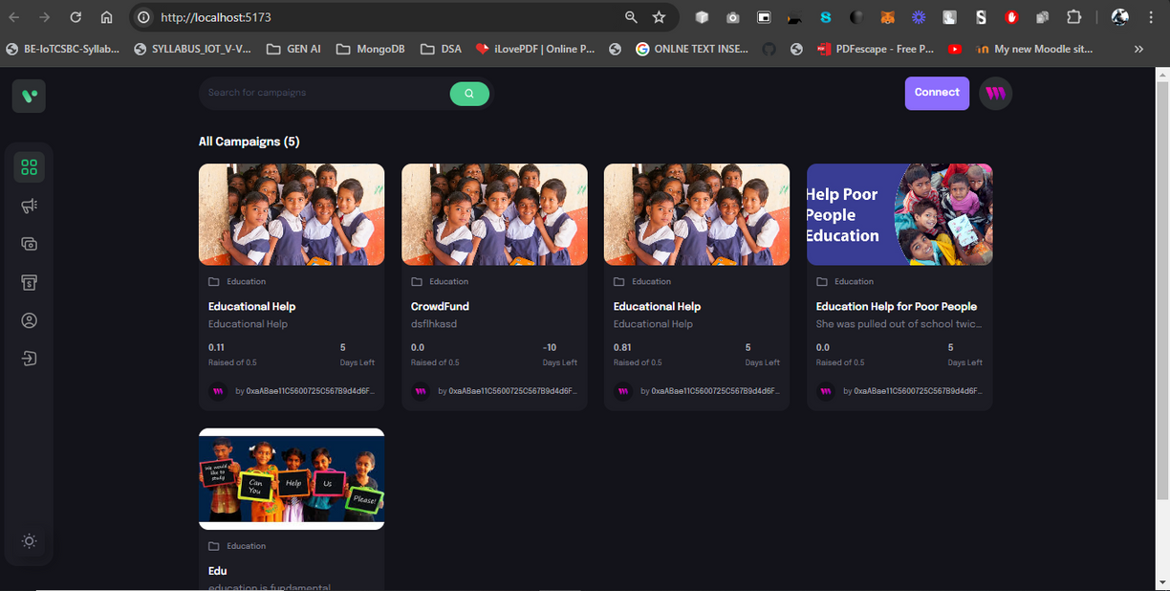

Result:

Slide 13
THANK YOU !

Slide 14
Conclusion:
This innovative approach to fundraising has the potential to revolutionize the way educational projects are funded, allowing for a more democratic and inclusive process. By leveraging blockchain technology, crowdfunding in education can provide a secure and efficient way for donors to support causes they believe in, while also ensuring that funds are used for their intended purpose. Additionally, the transparency of blockchain technology can help build trust among donors and recipients, ultimately leading to more successful and impactful educational initiatives.
Overall, crowdfunding in education using blockchain technology has the power to transform the way we support and invest in education, creating a more equitable and sustainable future for learners around the world.

Slide 15

REFERENCES:
[1] K. Christidis and M. Devetsikiotis, “Blockchains and smart contracts for the internet of things,” Ieee Access vol. 4, pp. 2292–2303, 2016.
[2] Y. He, H. Li, X. Cheng, Y. Liu, C. Yang, and L. Sun, “A blockchain based truthful incentivemechanism for distributed p2p applications,”IEEE Access, vol. 6, pp. 27 324–27 335, 2018.
[3] V. Hassija, V. Chamola, S. Garg, N. G. K. Dara, G. Kaddoum, and D. N. K. Jayakody, “A blockchainbased framework for lightweightdata sharing and energy trading in v2g network,” IEEE Transactions on Vehicular Technology, 2020.
[4] Y. Hu, A. Manzoor, P. Ekparinya, M. Liyanage, K. Thilakarathna, G. Jourjon, and A. Seneviratne, “A delay-tolerant payment scheme based on the ethereum blockchain,” IEEE Access, vol. 7, pp. 33 159–33 172, 2019.
[5] V. Hassija, G. Bansal, V. Chamola, V. Saxena, and B. Sikdar, “Blockcom: A blockchain based commerce model for smart communities using auction mechanism,” in 2019 IEEE International Conference on Communications Workshops (ICC Workshops), May 2019, pp. 1–6. [7] A. C. Chapman and G. Verbic, “An iterative on-line auction mechanism for aggregated demand-side participation,” IEEE Transactions on Smart Grid, vol. 8, no. 1, pp. 158–168, 2017

